Slide 1
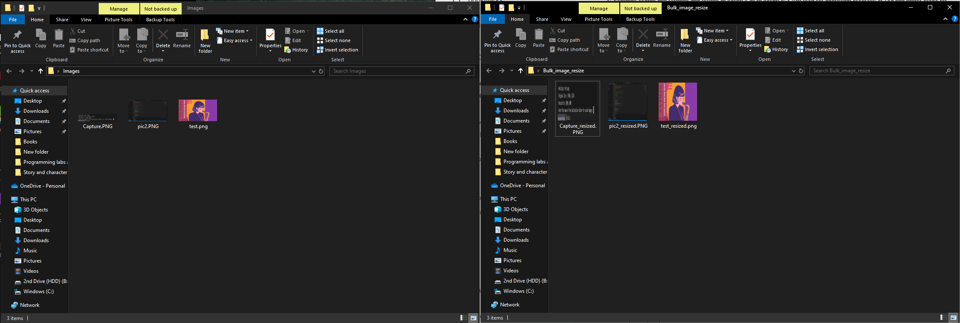
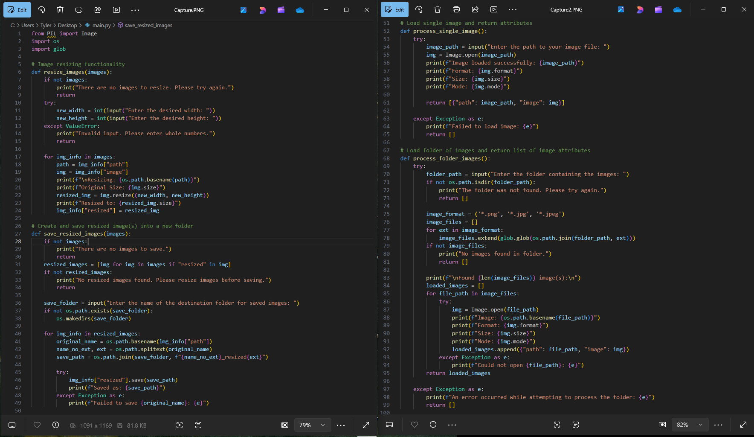
Bulk Image Resizer by: Tyler Fisher
The Bulk Image Resizer will allow the user to either upload a single image or a file with several images and allows them to change the original dimensions into desired dimensions. The program will then create a file on the desktop that contains the edited image(s).
Top: screenshot of the original picture file (left) and the edited picture file (right)
Bottom: Screenshot of the functions of the program

